Slide 1
Impossible Tree Sizes
We saw with a simple game like X’s and O’s how the Tree size can be very large.
Larger games can have an infinite number of possible moves.
  => We have to cut down the search space

Slide 2
Alpha-Beta Principle
If you have an idea and that idea is definitely bad
Then
Do not waste time finding out exactly how bad that idea is!
If we know a branch will not provide a better path then we do not search it
  The sooner we work this out the more pruning we can do
The Alpha-Beta search is a refinement of the Minimax algorithm

Slide 3
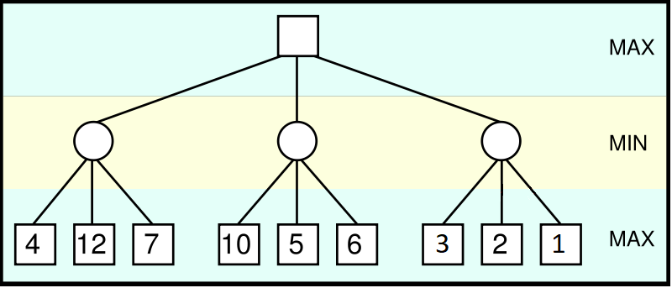
Alpha-Beta Pruning Example
4
5
Follow standard Minimax routine.

Slide 4
Alpha-Beta Pruning Example
4
5
3
From Max point of view, 3 is already lower than 4 or 5, so no need to evaluate 2 and 1 (bottom right) → Prune

Slide 5
Alpha-Beta Pruning Example
5
4
5
3
Move immediately to evaluate max value

Slide 6
Alpha-Beta
We use two bounds to mark out our worst solutions so far
  Alpha (α) is the worst that Max can do
    Given that Min will do his best
  Beta (β) is the worst that Min can do
    Given that Max will do his best
  Alpha (α) can never decrease
  Beta (β) can never increase

Slide 7
Alpha-Beta
Max need not consider any value less than Alpha(α)
  Because it is worse than the worst possible move I have already found!
Min need not consider any value greater than Beta(β)
  Because it scores higher than the highest scoring move I have already found
Alpha-Beta contains the range of values we accept
  Values outside this range can be pruned
It does not benefit the player to play any move outside this range
  → Saves processing time without affecting final result

Slide 8
Algorithm
When we begin, we set α to -∞ and β to +∞
We do a depth first search to a prefixed maximum bound
  Use iterative deepening to improve this later (how?)
MAX nodes modify the α value
MIN nodes modify the β value
When α >= β we prune the next branch

Slide 9
MiniMax Algorithm with Alpha-Beta Pruning
function MINIMAX-AB(N, Depth, Alpha, Beta)
begin
if leaf(N) or Depth = 0 then
return Estimate(N)
if N is a Min node then
For each successor Ni of N
Beta = min{Beta, MINIMAX-AB(Ni, Depth-1, Alpha, Beta)}
if Alpha >= Beta then
return Beta //Prune
end for
return beta
else //Max node
For each successor Ni of N
Alpha = max{Alpha, MINIMAX-AB(Ni, Depth-1, Alpha, Beta)}
if Alpha >= Beta then
return Alpha //Prune
end for
return alpha
end if
Notes:
Checkout:
http://will.thimbleby.net/algorithms/doku.php?id=minimax_search_with_alpha-beta_pruning
For an animated walk through.

Slide 10
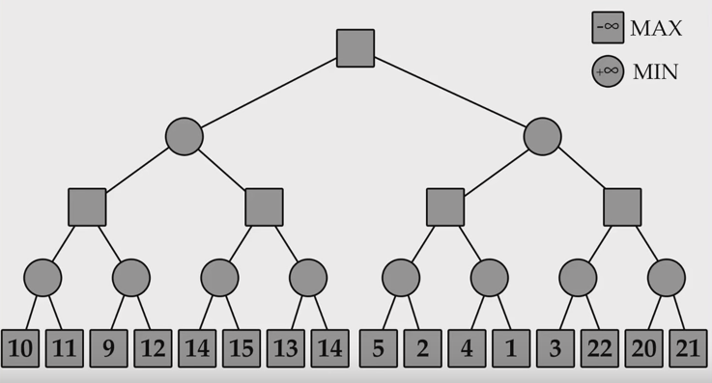

A walk through ...

Slide 11

A walk through ...
α≥β ?

Slide 12

A walk through ...

Slide 13

A walk through ...
α≥β ?

Slide 14

A walk through ...
α≥β ?

Slide 15
A walk through ...

Slide 16

A walk through ...
α≥β ?

Slide 17
A walk through ...

Slide 18
A walk through ...

Slide 19

A walk through ...

Slide 20

A walk through ...
α≥β ?

Slide 21
A walk through ...

Slide 22
Finish this..

